Slide 1
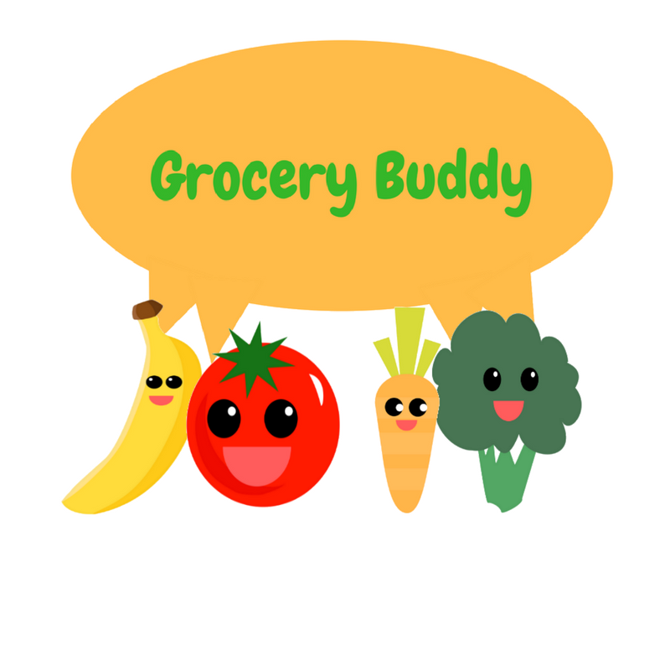
Grocery Buddy
By Ecoders (Patrick, Raly, Kevin, Toni, and Carlo)
Notes:
Patrick

Slide 2


What Does It Do?
“Make the most of out what you have”
Plan what you buy – Grocery Lists
Make sure you use it – Fridge expiry trackers and push notifications
Notes:
Patrick

Slide 3


What went well:
We learned a lot!
The UI turned out nicely!
The teamwork is excellent!
We got a lot of stuff done!
Excellent communication!
Notes:
Carlo

Slide 4

What didn’t go so well:
A lot of learning and fixing on the go!
Countless hours of fixing
More fixing………
Stress ☹
Caffeine consumption++
Notes:
Toni

Slide 5

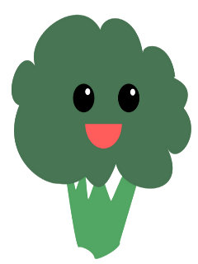

Workflow adjustments:
Planning
Smaller commits
Pull more frequently
Ask for help more often!
Half hour check-ins.
Notes:
Kevin

Slide 6

App Showcase:
Alt+Tab!
Notes:
Raly

Slide 7


Conclusion
THANKS!

